Slide 1








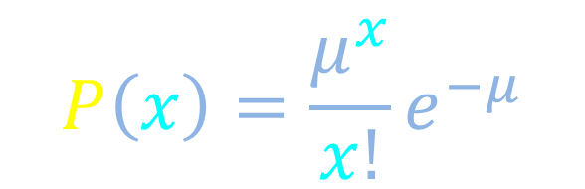

Poisson limit
$$P\left(x\right)=\frac{μ^{x}}{x!}e^{−μ}$$
$$N→∞$$
$$\left\langle x\right\rangle =N p$$
H
$$p=\frac{\left\langle x\right\rangle }{N}→0$$
$$\left\langle {δx}^{2}\right\rangle =\left\langle x\right\rangle$$
$$P\left(x\right)$$
T
H
T
H
0.4
$$μ=1$$
H
H
H
H
T
T
T
T
0.3
. . .
0.2
$$μ=4$$
$$μ=10$$
0.1
T
T
T
T
T
$$x$$
0
5
10
15
20
Distribution plot adapted from (http://en.wikipedia.org/wiki/File:Poisson_pmf.svg), licensed by Wikipedia user Skbkekas under a CC-BY-3.0 license.

Slide 2
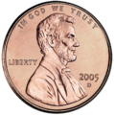













Poisson limit
?
$$N→∞$$
$$N=1$$
$$\left\langle x\right\rangle =N p$$
$$p=1$$
$$p=\frac{\left\langle x\right\rangle }{N}→0$$
$$\left\langle x\right\rangle =1$$
H
$$N=2$$
?
?
$$p=1/2$$
$$\left\langle x\right\rangle =1$$
T
H
T
H
$$N=4$$
?
?
?
?
$$p=1/4$$
$$\left\langle x\right\rangle =1$$
H
H
H
H
T
T
T
T

Slide 3




Poisson limit
$$N→∞$$
H
Average total number of heads
$$\left\langle x\right\rangle =N p$$
$$p=\frac{\left\langle x\right\rangle }{N}→0$$
T
H
T
H
Variance of total number of heads
$$\frac{\left\langle x\right\rangle }{N}$$
$$\frac{\left\langle x\right\rangle }{N}$$
H
H
H
H
$$\left\langle {δx}^{2}\right\rangle =N p \left(1− p \right)$$
T
T
T
T
$$\left\langle {δx}^{2}\right\rangle =\left\langle x\right\rangle$$
. . .
H
. . .
T
T
T
T
T
T
T
T

Slide 4







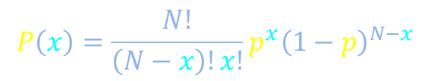

Poisson limit
$$\left\langle {δx}^{2}\right\rangle =\left\langle x\right\rangle$$
$$N→∞$$
H
$$\left\langle x\right\rangle =N p$$
Probability distribution for getting x total heads
$$p=\frac{\left\langle x\right\rangle }{N}→0$$
$$P\left(x\right)=\frac{N!}{\left(N−x\right)!x!}p^{x}{\left(1−p\right)}^{N−x}$$
T
H
T
H
$${\left(1−\frac{μ_{x}}{N} \right)}^{N−x}$$
$${\left(\frac{μ_{x}}{N}\right)}^{x}$$
$${\left(1−\frac{μ_{x}}{N} \right)}^{−x}$$
H
H
H
H
$${\left(1−\frac{μ_{x}}{N} \right)}^{N}$$
T
T
T
T
$$e^{−μ_{x}}$$
$$≈1$$
. . .
$$P\left(x\right)=\frac{N!}{\left(N−x\right)!x!}{\left(\frac{μ_{x}}{N}\right)}^{x}e^{−μ_{x}}$$
H
. . .
T
T
T
T
T
T
T
T

Slide 5
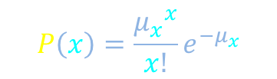
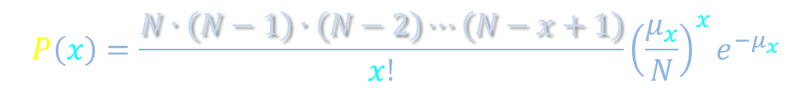
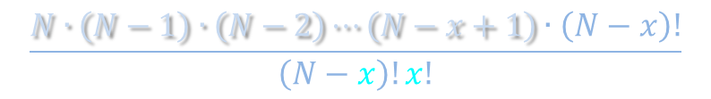

Poisson limit
$$\left\langle {δx}^{2}\right\rangle =\left\langle x\right\rangle$$
$$N→∞$$
H
$$\left\langle x\right\rangle =N p$$
Probability distribution for getting x total heads
$$p=\frac{\left\langle x\right\rangle }{N}→0$$
$$P\left(x\right)=\frac{N!}{\left(N−x\right)!x!}{\left(\frac{μ_{x}}{N}\right)}^{x}e^{−μ_{x}}$$
T
H
T
H
$$\frac{N∙\left(N−1\right)∙\left(N−2\right)⋯\left(N−x+1\right)∙\left(N−x\right)!}{\left(N−x\right)!x!}$$
H
H
H
H
T
T
T
T
$$P\left(x\right)=\frac{N∙\left(N−1\right)∙\left(N−2\right)⋯\left(N−x+1\right)}{x!}{\left(\frac{μ_{x}}{N}\right)}^{x}e^{−μ_{x}}$$
. . .
$$P\left(x\right)=\frac{{μ_{x}}^{x}}{x!}e^{−μ_{x}}$$
H
. . .
T
T
T
T
T
T
T
T

Slide 6

Poisson limit
$$P\left(x\right)=\frac{μ^{x}}{x!}e^{−μ}$$
$$N→∞$$
$$\left\langle x\right\rangle =N p$$
H
$$p=\frac{\left\langle x\right\rangle }{N}→0$$
$$\left\langle {δx}^{2}\right\rangle =\left\langle x\right\rangle$$
$$P\left(x\right)$$
T
H
T
H
0.4
$$μ=1$$
H
H
H
H
T
T
T
T
0.3
. . .
0.2
$$μ=4$$
$$μ=10$$
0.1
T
T
T
T
T
$$x$$
0
5
10
15
20
Distribution plot adapted from (http://en.wikipedia.org/wiki/File:Poisson_pmf.svg), licensed by Wikipedia user Skbkekas under a CC-BY-3.0 license.

